Slide 1
Capstone Project
Live Class Monitoring System (Face Emotion Recognition )
Deep Learning and MLE Project
Presented By:
Kartik Pandey

Slide 2
Contents
Introduction
Problem Statement
Data Summary
Dependencies
Model Creation
Sequential
2)Using DCNN layers
Loss & Accuracy Plot
Confusion Matrix
Real-time Local Video Face Detection
Deployment of Streamlit WebApp in Heroku and Streamlit
Various prediction Images from the WebApp
Challenges
Conclusions
Some Real Life Experience form project
2

Slide 3
Introduction
What is Face Emotion Recognition ?
Why it is so important?
What is the scopes of Face EmotionRecognition?
3

Slide 4
Problem Statement
The Indian education landscape has been undergoing rapid changes for the past 10 years owing to the advancement of web- based learning services, specifically, eLearning platforms.
Global E-learning is estimated to witness an 8X over the next 5 years to reach USD 2B in 2021.
India is expected to grow with a CAGR of 44% crossing the 10M users mark in 2021. Although the market is growing on a rapid
scale, there are major challenges associated with digital learning when compared with brick and mortar classrooms. One of many challenges is how to ensure quality learning for students. Digital platforms might overpower physical classrooms in terms of content quality but when it comes to understanding whether students are able to grasp the content in a live class scenario is yet an open-end challenge. In a physical classroom during a lecturing teacher can see the faces and assess the emotion of the class and tune their lecture accordingly, whether he is going fast or slow. He can identify students who need special attention.
Digital classrooms are conducted via video telephony software program (ex-Zoom) where it’s not possible for medium scale class (25-50) to see all students and access the mood. Because of this drawback, students are not focusing on content due to lack of surveillance.
While digital platforms have limitations in terms of physical surveillance but it comes with the power of data and machines which can work for you. It provides data in the form of video, audio, and texts which can be analyzed using deep learning algorithms. Deep learning backed system not only solves the surveillance issue, but it also removes the human bias from the system, and all information is no longer in the teacher’s brain rather translated in numbers that can be analyzed andtracked.
I will solve the above-mentioned challenge by applying deep learning algorithms to live video data. The solution to this problem is by recognizing facial emotions.
4

Slide 5
Data Summary
We have built a deep learning model which detects the real time emotions of students through a webcam so that teachers can understand if students are able to grasp the topic according to students' expressions or emotions and then deploy the model. The model is trained on the FER-2013 dataset .
This dataset consists of 35887 grayscale, 48x48 sized face images with seven emotions - angry, disgusted, fearful, happy, neutral, sad and surprised.
Here is the dataset link:-https://www.kaggle.com/ananthu017/emotion-detection-fer
Label Emotion Number of images for Training Number of images for Testing
● | 0 | angry | 3995 | 958
● | 1 | disgust | 436 | 111
● | 2 | fear | 4097 | 1024
● | 3 | happy | 7215 | 1774
● | 4 | sad | 4830 | 1247
● | 5 | surprised | 3171 | 831
● | 6 | neutral | 4965 | 1233
5

Slide 6
Dependencies
Python 3.8.8
Tensorflow 2.0
Streamlit 4.Streamlit Webrtc 5.OpenCV
6

Slide 7
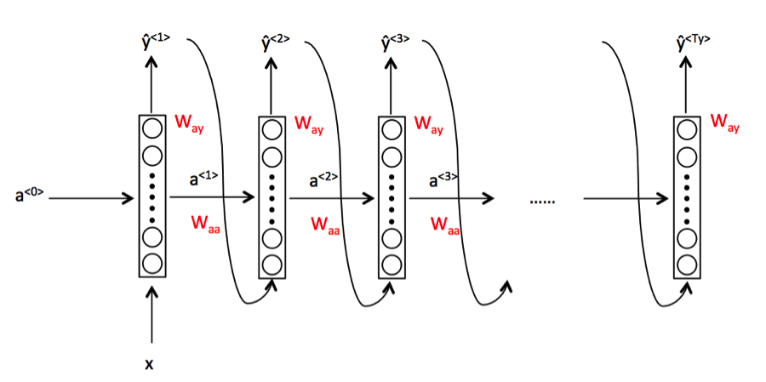
Model Creation
1)Sequential
What is Sequential?
Remarks for Sequential
7

Slide 8
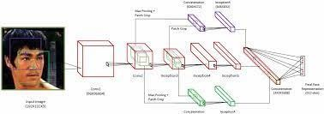
2)Using DCNNlayers
What is DCNN?
Remarks for DCNN.

Slide 9
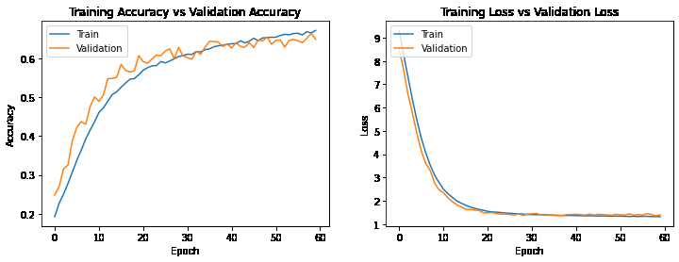
Loss & Accuracy Plot Method 1

Slide 10
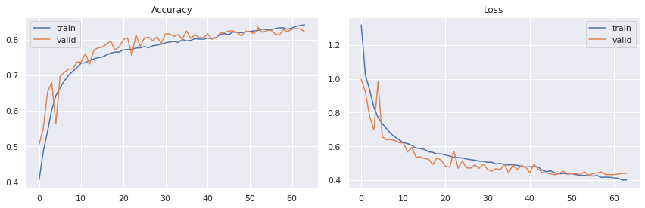
Loss & Accuracy Plot Method 2

Slide 11
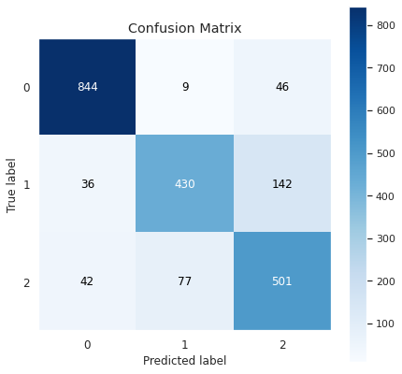
Confusion Matrix

Slide 12
The Above confusion matrix clearly shows that our model is doing good job on the class happy but it's performance is low on other two classes. One of the reason for this could be the fact that these two classes have less data. But when We looked at the images We found some images from these two classes are even hard for a human to tell whether the person is sad or neutral. Facial expression depends on individual as well. Some person's neutral face looks like sad.

Slide 13
Real-Time Local Video Face Emotion Detection
We created one patterns for detecting and predicting single faces and as
well
as multiple faces using OpenCV videocapture in local.
For Webapp , OpenCV can’t be used. Thus, using Streamlit-Webrtc for front-end application.

Slide 14
Deployment of Streamlit WebApp in Heroku and Streamlit
We deploy the app in streamlit but it invite the new user and it take time so after taht we use heroku and then we start deploy the app if you see the in the starting section you see the app name emotion45 but it not deploy we try as much as possible and then we put the link of app. But in local system it ran properly and app also fine

Slide 15
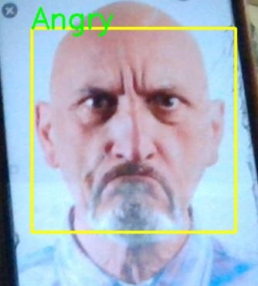
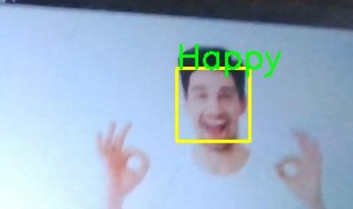
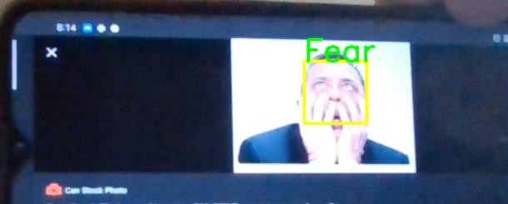
Various prediction Images from the WebApp

Slide 16
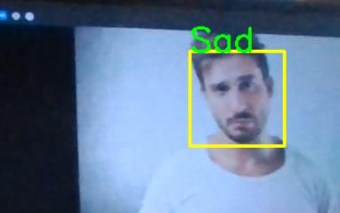
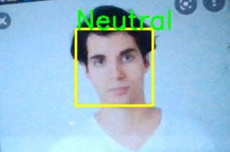
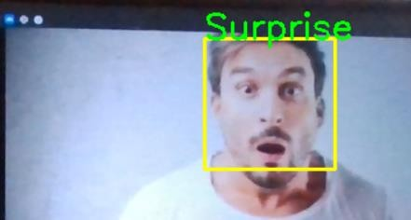

Slide 17
Challenges
Large Image Dataset to handle.
Couldn’t able to connect GPU with Jupyter Notebook.
Tried only two method because of we don’t have much faster computer.
Continuous Runtime and RAM Crash due to large dataset.
Carefully tuned Hyper parameters .
16

Slide 18
Conclusion
The model which was created by CNN layers gave training accuracy of 72.5% and test accuracy of 56% .
We have also included the video of my WebApp working in Local.
Codes which are deployed are in Github Repository.
It was such an amazing and interesting project. We learnt a lot from this.
16

Slide 19
Some real life experience form
project
Understand the deep concept of project
Don't afraid to faliure
From more faliure you get more experience and success will come
Never give up
Have some patience good things happen
Try new things and execute your idea
.
17

Slide 20
THANK YOU
Q & A
18

